Slide 1
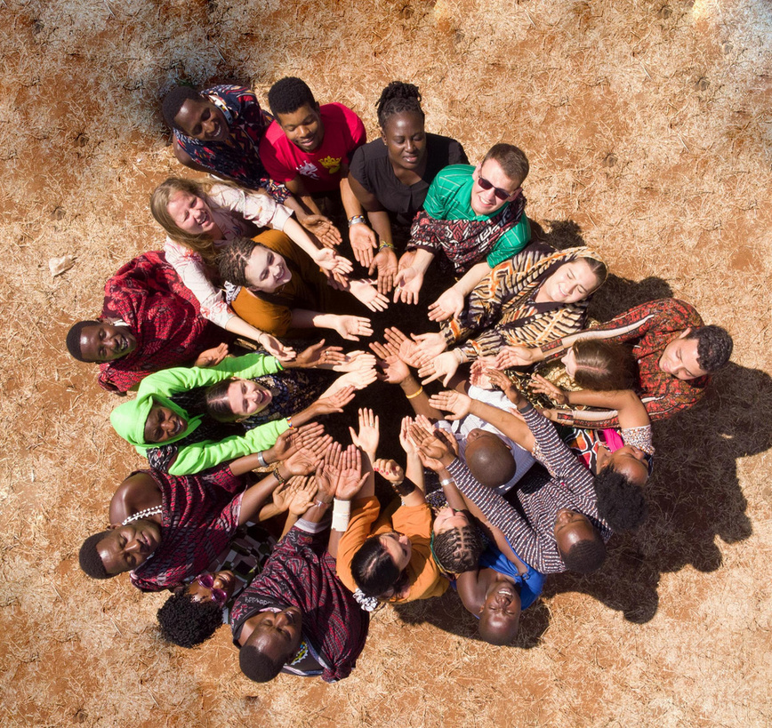
April 2026
FROM PUZZLE PIECES
TO COMMON GROUND

Slide 2
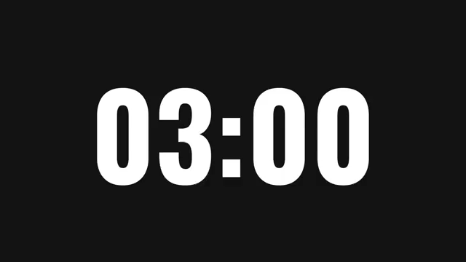
Mind-map

Slide 3

Role-play
Your task is to prepare a short role play and act it out.
In each group:
  choose a few people who will act
  choose 2–3 people who will think about a solution and present it
  and 2–3 people will get a worksheet with questions to answer while you work

Slide 4


Slide 5
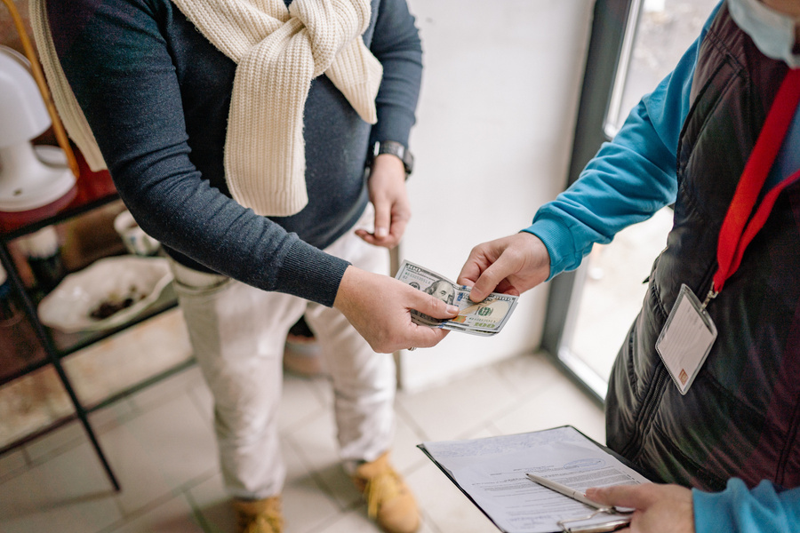
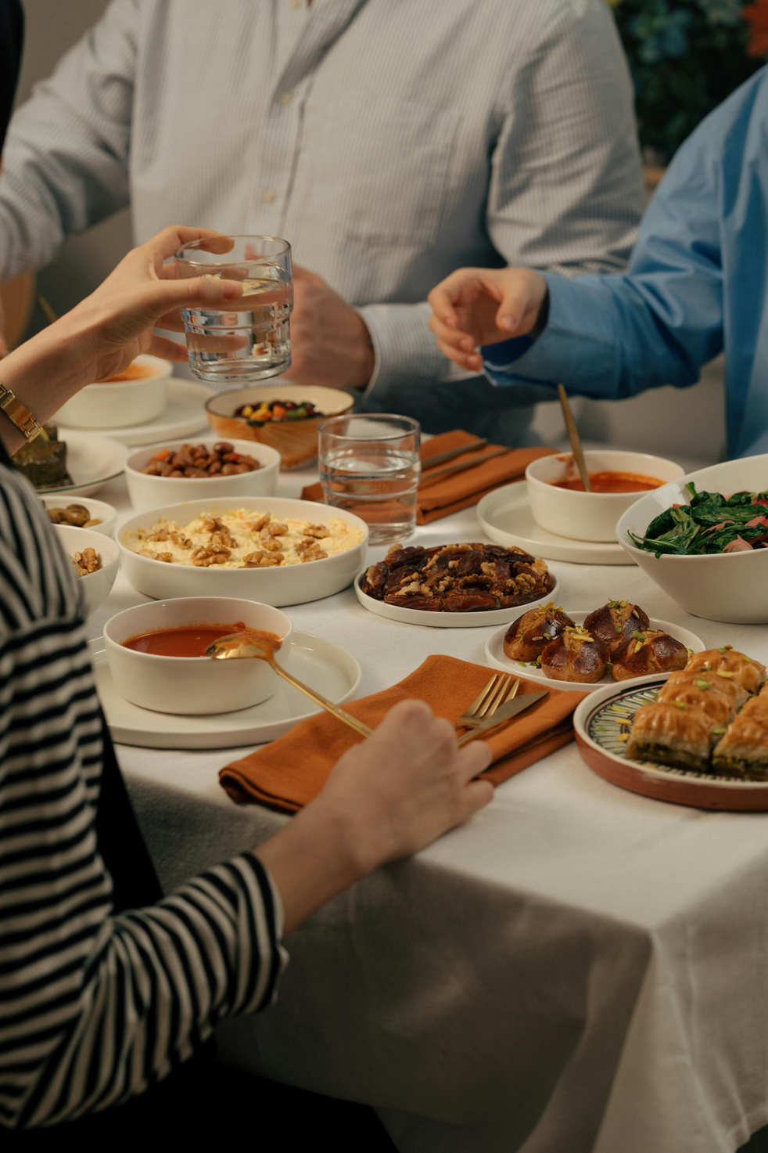
1.
ROLE-PLAY
Cultural Misunderstanding
    An exchange student during dinner with the host family is talking about salaries
    The host family becomes visibly uncomfortable
    The exchange student doesn’t know that talking about money at the dinner feels inappropriate and too direct in their culture.

Slide 6
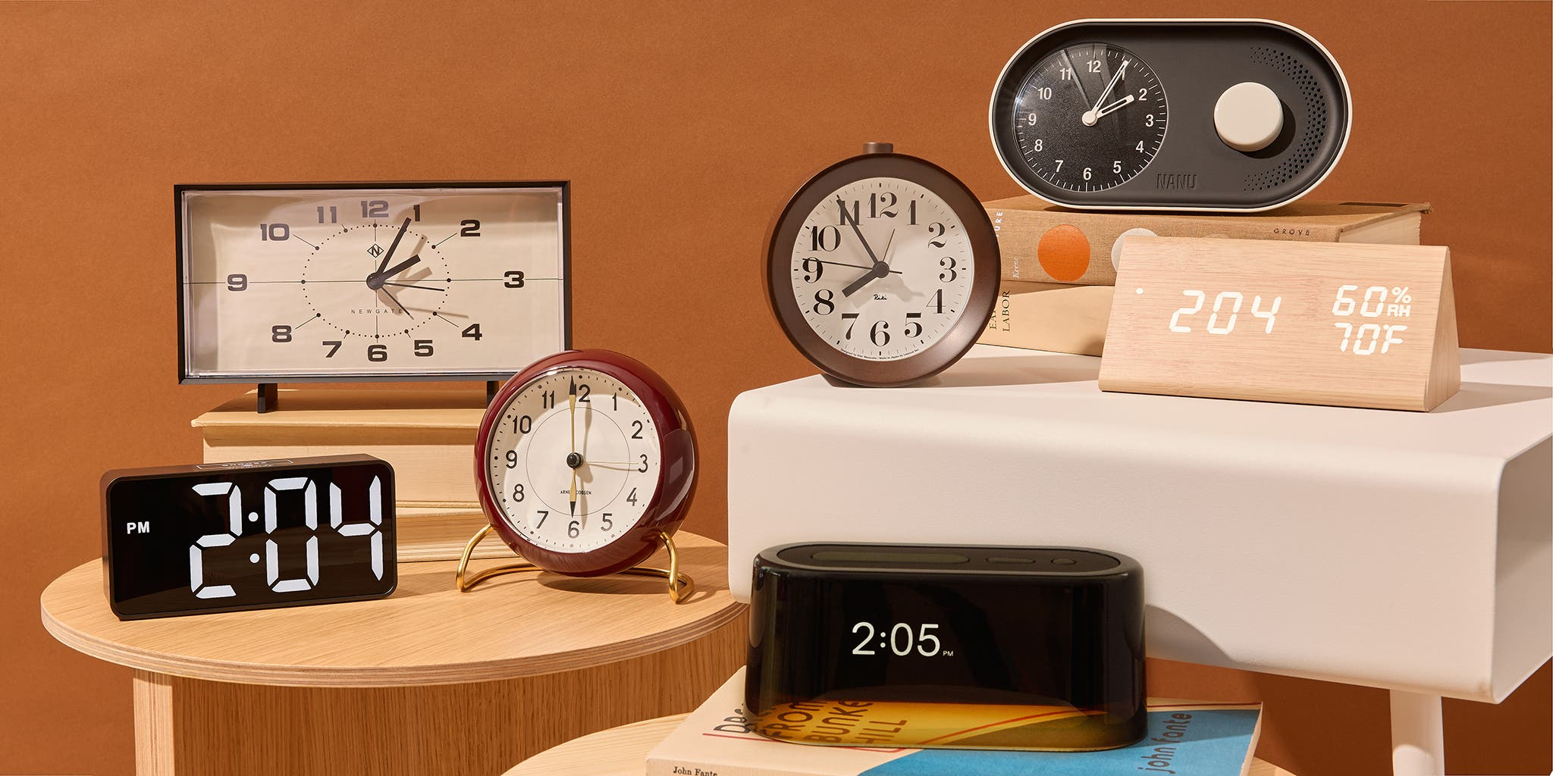
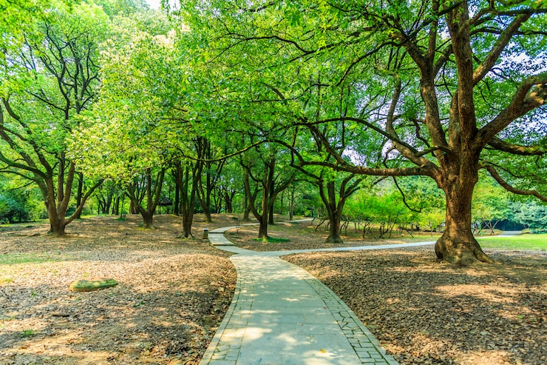
2.
ROLE-PLAY
Cultural Misunderstanding
    An exchange student arrives exactly on time to meet friends
    The others arrive later, relaxed
    The student feels confused and disrespected
    The group doesn’t see being late as a problem

Slide 7
differences
respect
culture
background
unity
cooperation
values
teamwork
better life
ideas
UNITY IN DIVERSITY
communication
understanding
tolerance
relationships
peace
acceptance

Slide 8
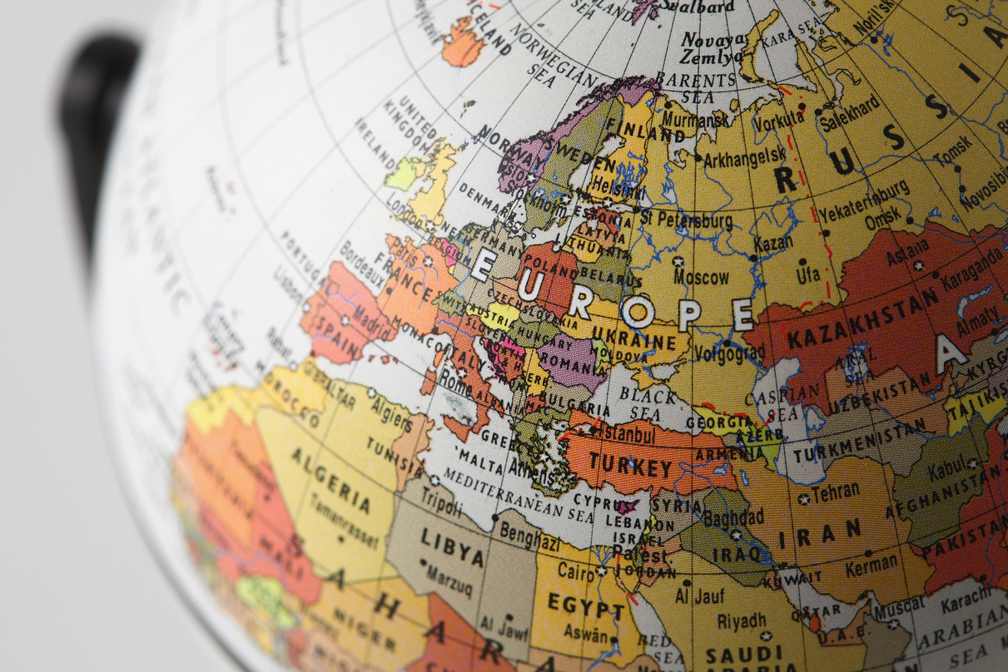
EUROPE PUZZLE
1 exercise - If our piece disappeared
    Without our region, Europe would lose ...
    We bring ... to Europe.
    We are different from the rest of Europe because ...
    People recognize us for ...
write every sentence on a separate paper and with capital letters

Slide 9
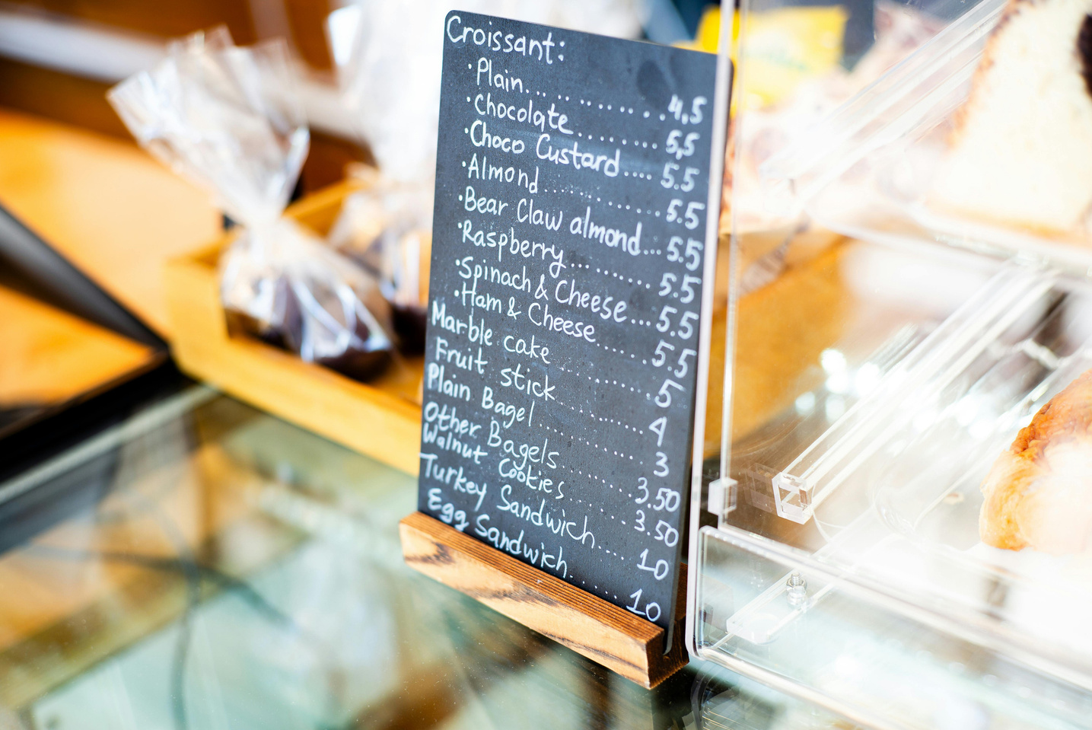

EUROPE PUZZLE
2 exercise - Making a menu
    according to your puzzle piece you received a menu template that need to be completed and filled with traditional foods from that region
2-3 people from group should explain:
  why you chose those dishes
  what seemed interesting or special about them
  why you would like to try them

Slide 10
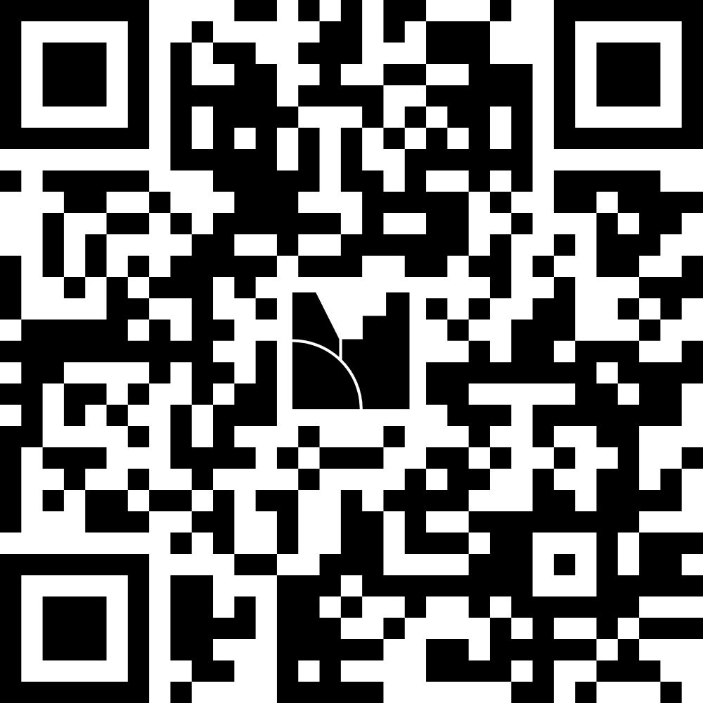
MENTIMETER
https://www.mentimeter.com/app/presentation/altj9qh1n4txa37a5k3zpgeuzcb84z2u/edit?source=share-modal

